Slide 1
Classification

Slide 2
Classification vs. Prediction
Classification
  Predicts categorical class labels (discrete or nominal)
  Classifies data (constructs a model) based on the training set and the values (class labels) in a classifying attribute and uses it in classifying new data.
  For example, we can build a classification model to categorize bank loan applications as either safe or risky.
Prediction
  models continuous-valued functions, i.e., predicts unknown or missing values
Typical applications
  Credit approval
  Target marketing

Slide 3
Classification—A Two-Step Process
Data classification is a two-step process:
Learning step (where a classification model is constructed)
Classification step (where the model is used to predict class labels for given data).
In the learning step (or training phase), a classification algorithm builds the classifier by analyzing or “learning from” a training set.
A tuple, X, is represented by an N-dimensional attribute vector,
    X ={x1, x2,……..xN}
Each tuple, X, is assumed to belong to a predefined class as determined by another database attribute called the class label attribute.
The individual tuples making up the training set are referred to as training tuples and are randomly sampled from the database under analysis.

Slide 4
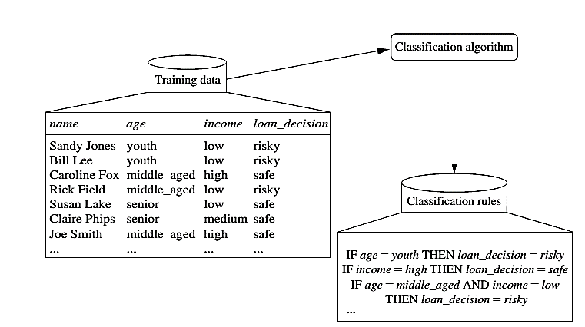
Learning

Slide 5
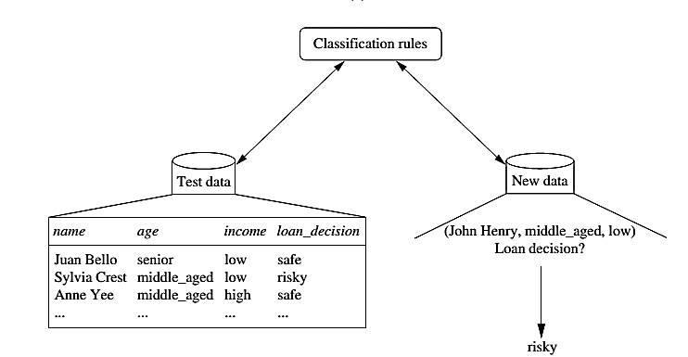
Classification

Slide 6



Process (1): Model Construction
Classification
Algorithms
Training
Data
Classifier
(Model)
IF rank = ‘professor’
OR years > 6
THEN tenured = ‘yes’

Slide 7


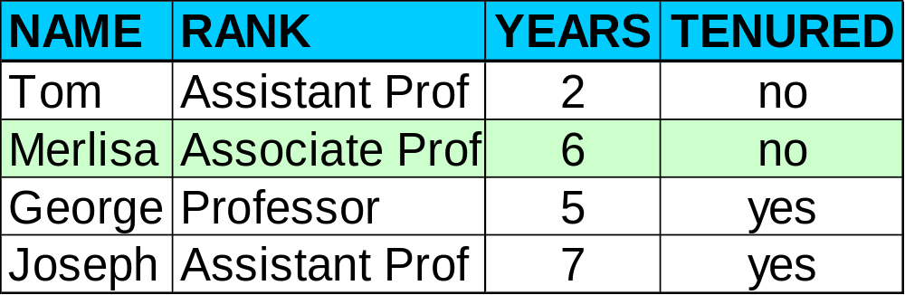

Process (2): Using the Model in Prediction
Classifier
Testing
Data
Unseen Data
(Jeff, Professor, 4)
Tenured?

Slide 8
Supervised vs. Unsupervised Learning
Supervised learning (classification)
  Supervision: The training data (observations, measurements, etc.) are accompanied by labels indicating the class of the observations
  New data is classified based on the training set
Unsupervised learning (clustering)
  The class labels of training data is unknown
  In this we can predict the class labels by using clustering technique.

Slide 9
Issues regarding Classification & Prediction

Slide 10
Issues: Data Preparation
Data cleaning
  Preprocess data in order to reduce noise and handle missing values
Relevance analysis (feature selection)
  Remove the irrelevant or redundant attributes
Data transformation
  Generalize and/or normalize data

Slide 11
Issues: Evaluating Classification Methods
Accuracy: classifier accuracy: predicting class label
Speed: time to construct the model (training time)
  time to use the model (classification/prediction time)
Robustness: handling noise and missing values
Scalability: efficiency in disk-resident databases
Other measures, e.g., goodness of rules, such as decision tree size or compactness of classification rules

Slide 12
Decision Tree Induction

Slide 13
Decision Tree Induction
Decision tree induction is the learning of decision trees from class-labeled training tuples.
A decision tree is a flowchart-like tree structure, where each internal node (non-leaf node) denotes a test on an attribute, each branch represents an outcome of the test, and each leaf node (or terminal node ) holds a class label.
The topmost node in a tree is the root node.

Slide 14
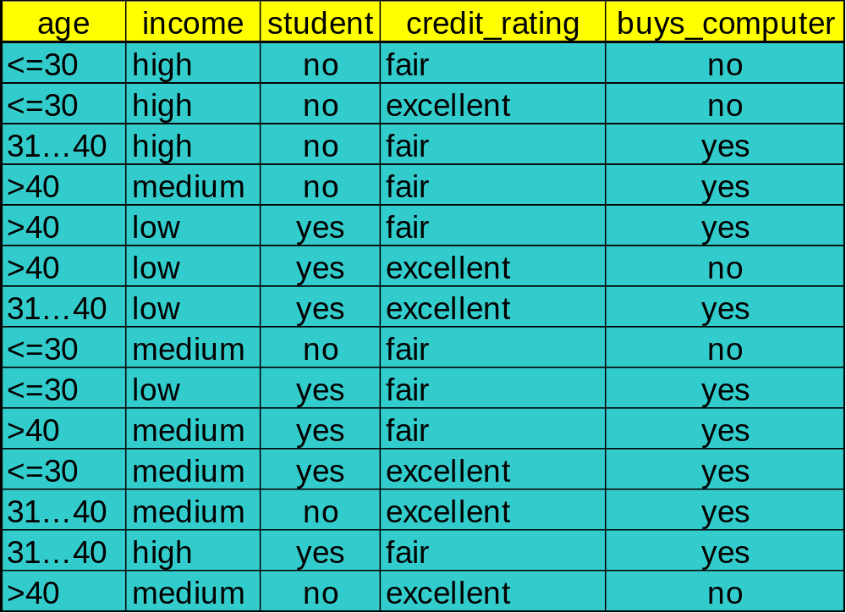
Decision Tree Induction: Training Dataset

Slide 15
Output: A Decision Tree for “buys_computer”
age?
<=30
>40
31….40
student?
yes
credit rating?
Excellent
Fair
NO
YES
no
yes
no
yes

Slide 16
How are decision trees used for classification?
Given a tuple, X, for which the associated class label is unknown.
The attribute values of the tuple are tested against the decision tree.
A path is traced from the root to a leaf node, which holds the class prediction for that tuple.
Decision trees can easily be converted to classification rules.

Slide 17
Why are decision tree classifiers so popular?
The construction of decision tree classifiers does not require any domain knowledge or parameter setting, and therefore is appropriate for exploratory knowledge discovery. Decision trees can handle multidimensional data.
Their representation of acquired knowledge in tree form is intuitive and generally easy to understand by humans.
The learning and classification steps of decision tree induction are simple and fast. In general, decision tree classifiers have good accuracy.

Slide 18
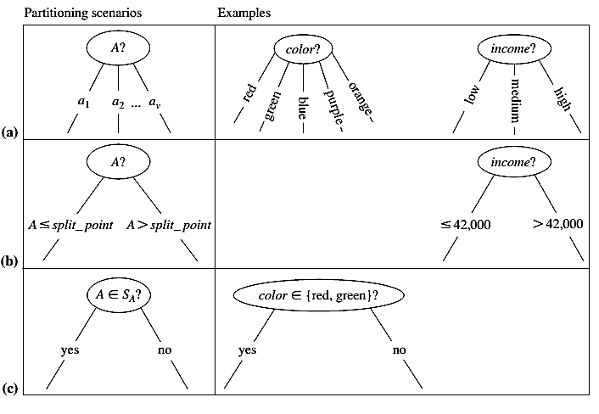
Attribute Selection Criteria
It is used to determine the splitting criterion.

Slide 19
Attribute Selection Criteria
A is discrete-valued: In this case, the outcomes of the test at node N correspond directly to the known values of A.
A is continuous-valued: In this case, the test at node N has two possible outcomes, corresponding to the conditions A <= split point and A >= split point, respectively.
A is discrete-valued in Set form.

Slide 20

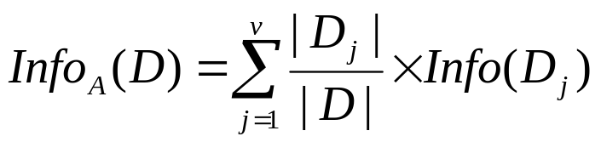

Attribute Selection Measure: Information Gain
Select the attribute with the highest information gain
Let p_{i} be the non- zero probability that an arbitrary tuple in D belongs to class C_{i}, estimated by |C_{i, D}|/|D|
Initial entropy:
A log function to the base 2 is used, because the information
is encoded in bits.
New entropy (after using A to split D into v partitions) to classify D:
Information gained by branching on attribute A
Notes:
I : the expected information needed to classify a given sample
E (entropy) : expected information based on the partitioning into subsets by A

Slide 21
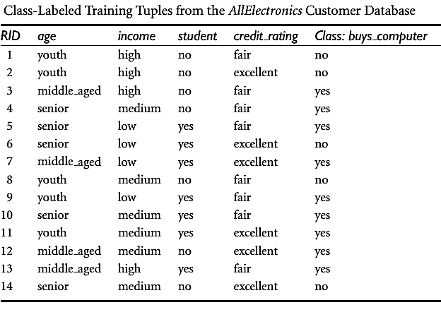
Attribute Selection Measure: Information Gain

Slide 22

Attribute Selection Measure: Information Gain
The class label attribute, buys_computer, has two distinct values (namely, {yes, no}); therefore, there are two distinct classes (i.e., m = 2).
There are nine tuples of class yes and five tuples of class no.

Slide 23

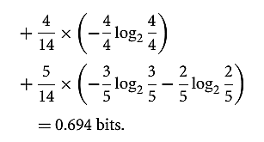


We need to look at the distribution of yes and no tuples for each category of age. For the age category “youth,” there are two yes tuples and three no tuples. For the category “middle aged,” there are four yes tuples and zero no tuples. For the category “senior,” there are three yes tuples and two no tuples.

Slide 24
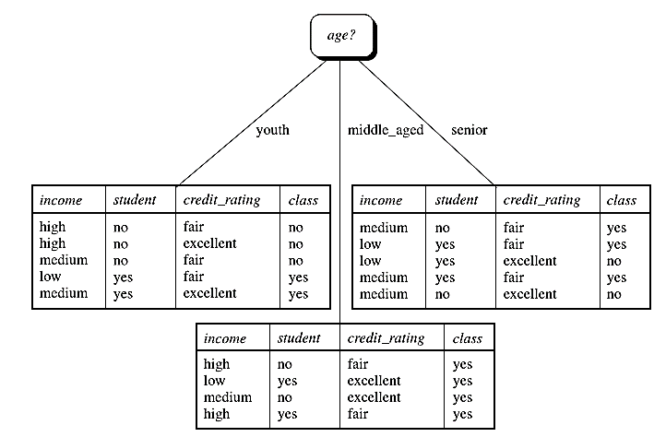

Slide 25
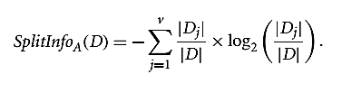

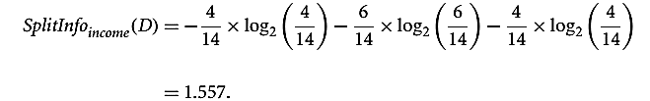
Attribute Selection Measure:
Gain Ratio
A test on income splits the data into three partitions, namely low, medium, and high, containing four, six, and four tuples, respectively.
Gain(Income) = 0.029
Gain Ratio (Income) = 0.029 / 1.557 = 0.019

Slide 26

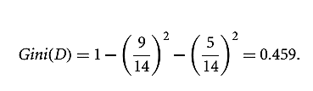
Attribute Selection Measure:
Gini Index
The Gini index is used in CART. Using the notation previously described, the Gini index measures the impurity of D, a data partition or set of training tuples, as

Slide 27
Over-fitting and Tree Pruning
Over-fitting: An induced tree may over-fit the training data
  Too many branches, some may reflect anomalies due to noise or outliers
Two approaches to avoid over-fitting
  Pre-pruning: Halt tree construction early—do not split a node if this would result in the goodness measure falling below a threshold
    Difficult to choose an appropriate threshold
  Post-pruning: Remove branches from a “fully grown” tree—get a sequence of progressively pruned trees
    Use a set of data different from the training data to decide which is the “best pruned tree”

Slide 28
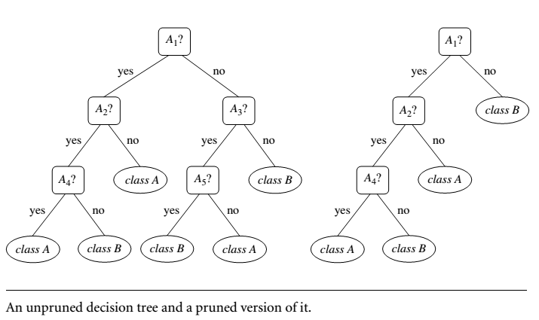
Example

Slide 29
Bayesian Classification

Slide 30
Bayesian Classification: Why?
It is a statistical classifier, it can predict class membership probabilities such as the probability that a given tuple belongs to a particular class.
It is based on Bayes’ Theorem.
A simple Bayesian classifier, naïve Bayesian classifier, has comparable performance with decision tree and selected neural network classifiers

Slide 31
Bayesian Theorem: Basics
Let X be a data sample (“evidence”): class label is unknown.
Let H be a hypothesis that X belongs to class C.
Classification is to determine P(H|X) is the posteriori probability, of H conditioned on X.
X is a 35-year-old customer with an income of $40,000.
Then P(H/X) reflects the probability that customer X will buy a computer given that we know the customer’s age and income.
In contrast, P(H) is the prior probability, of H .
For our example, this is the probability that any given customer will buy a computer, regardless of age, income, or any other information.
P(H), which is independent of X.

Slide 32
Bayesian Theorem: Basics
P(X|H) (posteriori probability), the probability of X conditioned on H. That is, it is the probability that a customer, X, is 35 years old and earns $40,000, given that we know the customer will buy a computer.
P(X) is the prior probability of X.
Using our example, it is the probability that a person from our set of customers is 35 years old and earns $40,000.

Slide 33
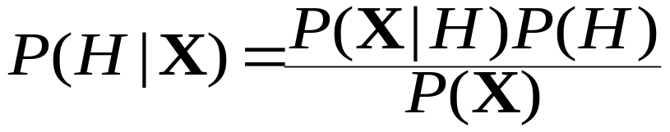
Bayesian Theorem
Given training data X, posteriori probability of a hypothesis H, P(H|X), follows the Bayes theorem

Slide 34


Derivation of Naïve Bayesian Classifier
Let D be a training set of tuples and their associated class labels, and each tuple is represented by an n-D attribute vector X = (x₁, x₂, …, x_{n})
Suppose there are m classes C₁, C₂, …, C_{m}.
Classification is to derive the maximum posteriori, i.e., the maximal P(C_{i}|X)
This can be derived from Bayes’ theorem
Since P(X) is constant for all classes, only
  needs to be maximized

Slide 35
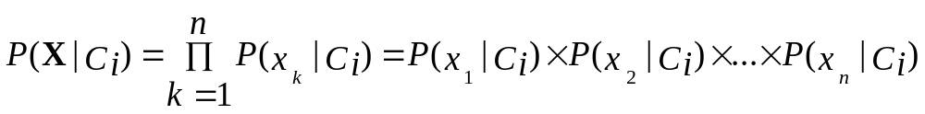
Derivation of Naïve Bayes Classifier
A simplified assumption: attributes are conditionally independent (i.e., no dependence relation between attributes):
For instance, to compute P(X/Ci), we consider the following:

Slide 36

Naïve Bayesian Classifier: Training Dataset
Class:
C1:buys_computer = ‘yes’
C2:buys_computer = ‘no’
Data sample
X = (age <=30,
Income = medium,
Student = yes
Credit_rating = Fair)

Slide 37
Naïve Bayesian Classifier: An Example
P(C_{i}): P(buys_computer = “yes”) = 9/14 = 0.643
P(buys_computer = “no”) = 5/14= 0.357
Compute P(X|C_{i}) for each class
P(age = “<=30” | buys_computer = “yes”) = 2/9 = 0.222
P(age = “<= 30” | buys_computer = “no”) = 3/5 = 0.6
P(income = “medium” | buys_computer = “yes”) = 4/9 = 0.444
P(income = “medium” | buys_computer = “no”) = 2/5 = 0.4
P(student = “yes” | buys_computer = “yes) = 6/9 = 0.667
P(student = “yes” | buys_computer = “no”) = 1/5 = 0.2
P(credit_rating = “fair” | buys_computer = “yes”) = 6/9 = 0.667
P(credit_rating = “fair” | buys_computer = “no”) = 2/5 = 0.4
X = (age <= 30 , income = medium, student = yes, credit_rating = fair)
P(X|C_{i}) : P(X|buys_computer = “yes”) = 0.222 x 0.444 x 0.667 x 0.667 = 0.044
P(X|buys_computer = “no”) = 0.6 x 0.4 x 0.2 x 0.4 = 0.019
P(X|C_{i})*P(C_{i}) : P(X|buys_computer = “yes”) * P(buys_computer = “yes”) = 0.028
P(X|buys_computer = “no”) * P(buys_computer = “no”) = 0.007
Therefore, X belongs to class (“buys_computer = yes”)

Slide 38
Naïve Bayesian Classifier: Comments
Advantages
  Easy to implement
  Good results obtained in most of the cases
Disadvantages
  Assumption: class conditional independence, therefore loss of accuracy
  Practically, dependencies exist among variables
    E.g., hospitals: patients: Profile: age, family history, etc.
    Symptoms: fever, cough etc., Disease: lung cancer, diabetes, etc.
    Dependencies among these cannot be modeled by Naïve Bayesian Classifier

Slide 39
Types of Naive Bayes Classifier
Multinomial Naive Bayes:
This is mostly used for document classification problem, i.e whether a document belongs to the category of sports, politics, technology etc. The features/predictors used by the classifier are the frequency of the words present in the document.

Slide 40
Bernoulli Naive Bayes:
This is similar to the multinomial naive bayes but the predictors are boolean variables. The parameters that we use to predict the class variable take up only values yes or no, for example if a word occurs in the text or not.

Slide 41
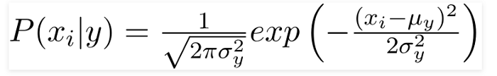
Gaussian Naive Bayes:
When the predictors take up a continuous value and are not discrete, we assume that these values are sampled from a gaussian distribution.
Since the way the values are present in the dataset changes, the formula for conditional probability changes to,

Slide 42

Example
Example: Play Tennis

Slide 43
Learning Phase
P(Outlook=o|Play=b) P(Temperature=t|Play=b)
Outlook | Play=Yes | Play=No
Sunny | 2/9 | 3/5
Overcast | 4/9 | 0/5
Rain | 3/9 | 2/5
Temperature | Play=Yes | Play=No
Hot | 2/9 | 2/5
Mild | 4/9 | 2/5
Cool | 3/9 | 1/5
P(Humidity=h|Play=b) P(Wind=w|Play=b)
Humidity | Play=Yes | Play=No
High | 3/9 | 4/5
Normal | 6/9 | 1/5
Wind | Play=Yes | Play=No
Strong | 3/9 | 3/5
Weak | 6/9 | 2/5
P(Play=Yes) = 9/14
P(Play=No) = 5/14

Slide 44
Example
Test Phase
  Given a new instance,
  x’=(Outlook=Sunny, Temperature=Cool, Humidity=High, Wind=Strong)
  Look up tables
  MAP rule
P(Outlook=Sunny|Play=Yes) = 2/9
P(Temperature=Cool|Play=Yes) = 3/9
P(Huminity=High|Play=Yes) = 3/9
P(Wind=Strong|Play=Yes) = 3/9
P(Play=Yes) = 9/14
P(Outlook=Sunny|Play=No) = 3/5
P(Temperature=Cool|Play==No) = 1/5
P(Huminity=High|Play=No) = 4/5
P(Wind=Strong|Play=No) = 3/5
P(Play=No) = 5/14
P(Yes|x’): [P(Sunny|Yes)P(Cool|Yes)P(High|Yes)P(Strong|Yes)]P(Play=Yes) = 0.0053
P(No|x’): [P(Sunny|No) P(Cool|No)P(High|No)P(Strong|No)]P(Play=No) = 0.0206
Given the fact P(Yes|x’) < P(No|x’), we label x’ to be “No”.

Slide 45
Conclusion
Naive Bayes algorithms are mostly used in sentiment analysis,
spam filtering,
recommendation systems
They are fast and easy to implement but their biggest disadvantage is that the requirement of predictors to be independent.
In most of the real life cases, the predictors are dependent, this hinders the performance of the classifier.

Slide 46
Rule Based Classification

Slide 47
Using IF-THEN Rules for Classification
Rules are a good way of representing information or bits of knowledge. A rule-based classifier uses a set of IF-THEN rules for classification. An IF-THEN rule is an expression of the form
IF condition THEN conclusion
  R1: IF age = youth AND student = yes THEN buys_computer = yes
The “IF” part (or left side) of a rule is known as the rule antecedent or precondition. The “THEN” part (or right side) is the rule consequent.
In the rule antecedent, the condition consists of one or more attribute tests and the rule’s consequent contains a class prediction. R1 can also be written as:

Slide 48
Using IF-THEN Rules for Classification
If the condition holds true for a given tuple, we say that the rule antecedent is satisfied and that rule covers the tuple.
Assessment of a rule: coverage and accuracy
  n_{covers} = # of tuples covered by R
  n_{correct} = # of tuples correctly classified by R
  coverage(R) = n_{covers} / |D| /* D: training data set */
  accuracy(R) = n_{correct} / n_{covers}

Slide 49
The Rule Based Data Mining Classifier is a well-known technique used for data mining.
Rules are a good way of representing information and can easily be read and understood.
The efficiency of a rule-based classifier depends on factors such as the quality of the rules, rule ordering, and properties of the set of rules.

Slide 50
The idea behind rule based Data Mining classifiers is to find regularities and different scenarios in data expressed in the IF-THEN rule. A collection of IF-THEN rules is used for classification and predicting the outcome. IF-THEN rules are defined as
IF condition THEN conclusion

Slide 51
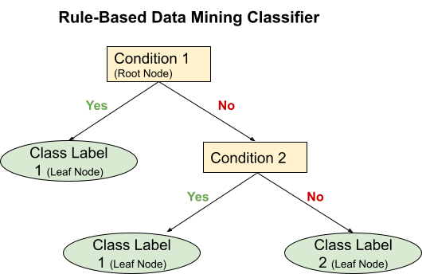
Properties of Rule Based Data Mining Classifiers

Slide 52
Rule Antecedent: The Left Hand Side(“IF” part) of a rule is called the rule antecedent or condition. The antecedent may have one or more conditions, which are logically ANDed. These conditions are nothing but splitting criteria that are logically ANDed.
IF condition1 AND condition2 THEN conclusion
The first splitting criteria is a root node or start node.
Rule Consequent: The Right Hand Side(“THEN” part) of a rule is called the rule consequent. Rule consequent consists of class prediction. The class prediction is the leaf node or end node.

Slide 53
Assessment of Rule
Rule can be accessed based on two factors. Let’s define a few parameters first.
n_{a} = number of records covered by the rule(R).
n_{c} = number of records correctly classified by rule(R).
n = Total number of records
Coverage of a rule: Fraction of records that satisfy the rule’s antecedent describes rule coverage.
Coverage (R) = n_{a} / |n|
Accuracy of a rule: Fraction of records that meet the antecedent and consequent value defines rule accuracy.
Accuracy (R) = n_{c} / n_{a}

Slide 54
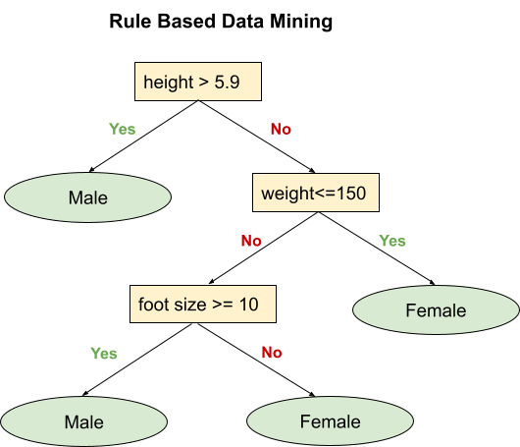
Example

Slide 55
According to the above diagram, if height is greater than 5.9 ft or if height is less than or equal to 5.9 ft and weight is greater than 150 lbs, and foot size is greater than or equal to 10 inches, then Gender is classified as ‘male.’ And if height is less than 5.9 ft and weight is less than or equal to 150 lbs or if height is less than 5.9 ft and foot size is less than 10 inches then Gender is classified as ‘female.’

Slide 56
Assessment of Rule
Let’s assess the rule ‘height is greater than 5.9 ft’ and say it R1
Here, the total number of records, i.e., n = 8
Number of records covered by rule R1 is n_{a}= 3
Number of records correctly classified by rule R1 is n_{c}= 3
coverage(R) = n_{a} / |n| = ⅜ = 37.5%
accuracy(R) = n_{c} / n_{a} = 3/3 = 100%
Here, coverage of rule R1 is 37.5%, and accuracy is 100%.

Slide 57
Associative classification
Associative classification (AC) is a data mining approach that combines association rule and classification to build classification models (classifiers).
a number of associative classification algorithms have been proposed such as Classification based Association (CBA), Classification based on Multiple Association Rules (CMAR), Class based Associative Classification (CACA), and Classification based on Predicted Association Rule (CPAR).

Slide 58
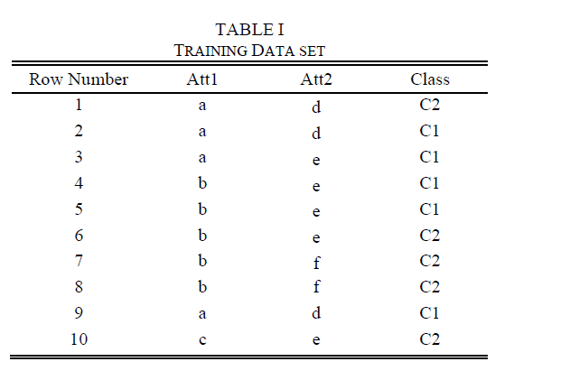

Slide 59
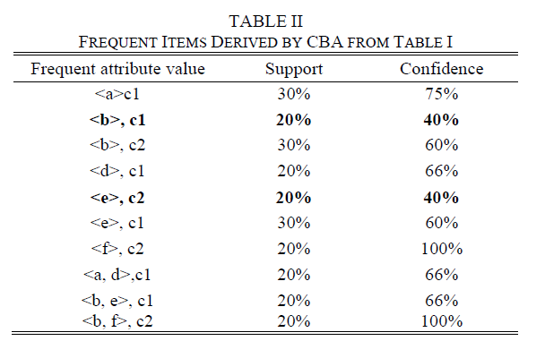

Slide 60
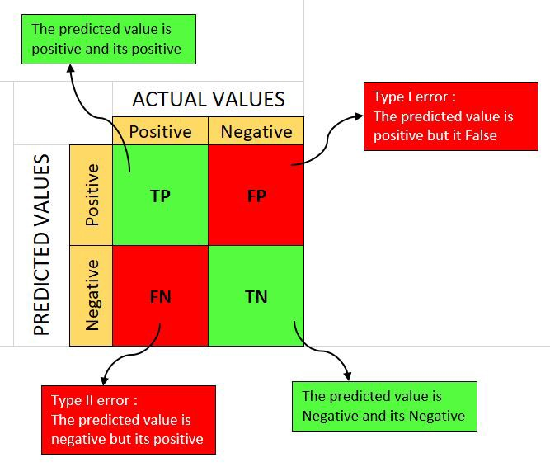

Confusion matrix

Slide 61
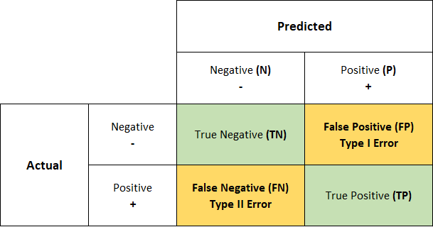
A good model is one which has high TP and TN rates, while low FP and FN rates.

Slide 62
True Positives (TP): when the actual value is Positive and predicted is also Positive.
True negatives (TN): when the actual value is Negative and prediction is also Negative.
False positives (FP): When the actual is negative but prediction is Positive. Also known as the Type 1 error
False negatives (FN): When the actual is Positive but the prediction is Negative. Also known as the Type 2 error

Slide 63
Let’s take an example:
We have a total of 20 cats and dogs and our model predicts whether it is a cat or not.
Actual values = [‘dog’, ‘cat’, ‘dog’, ‘cat’, ‘dog’, ‘dog’, ‘cat’, ‘dog’, ‘cat’, ‘dog’, ‘dog’, ‘dog’, ‘dog’, ‘cat’, ‘dog’, ‘dog’, ‘cat’, ‘dog’, ‘dog’, ‘cat’]
Predicted values = [‘dog’, ‘dog’, ‘dog’, ‘cat’, ‘dog’, ‘dog’, ‘cat’, ‘cat’, ‘cat’, ‘cat’, ‘dog’, ‘dog’, ‘dog’, ‘cat’, ‘dog’, ‘dog’, ‘cat’, ‘dog’, ‘dog’, ‘cat’]

Slide 64
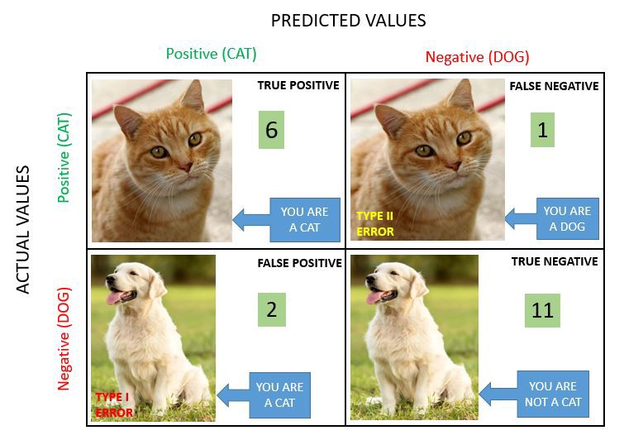

Slide 65
Classification Measure
Basically, it is an extended version of the confusion matrix. There are measures other than the confusion matrix which can help achieve better understanding and analysis of our model and its performance.
a. Accuracy
b. Precision
c. Recall (TPR, Sensitivity)
d. F1-Score
e. FPR (Type I Error)
f. FNR (Type II Error)

Slide 66
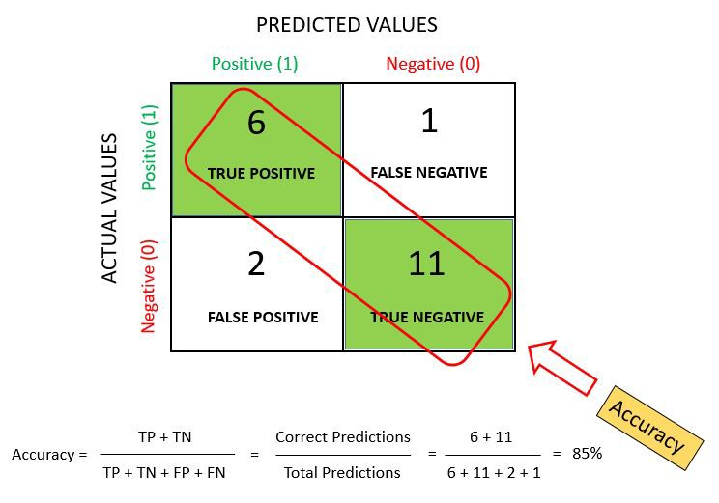
Accuracy

Slide 67
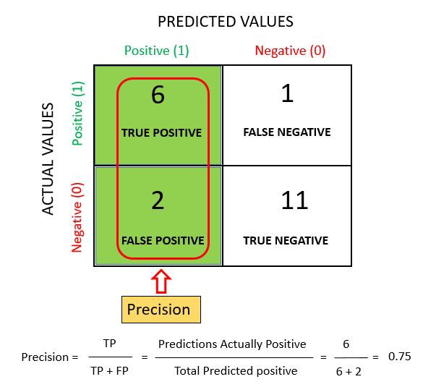
Precision

Slide 68
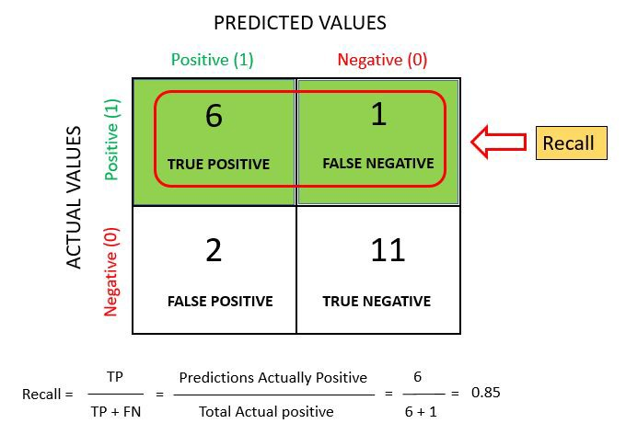
Recall or Sensitivity

Slide 69
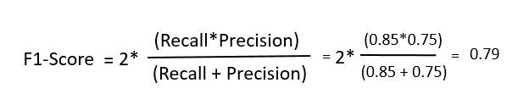
F-measure / F1-Score
The F1 score is a number between 0 and 1 and is the harmonic mean of precision and recall. We use harmonic mean because it is not sensitive to extremely large values, unlike simple averages.

Slide 70
Random Forest classification
Random forest is a Supervised Machine Learning Algorithm that is used widely in Classification and Regression problems. It builds decision trees on different samples and takes their majority vote for classification and average in case of regression.
One of the most important features of the Random Forest Algorithm is that it can handle the data set containing continuous variables as in the case of regression and categorical variables as in the case of classification. It performs better results for classification problems.

Slide 71
Why Use a Random Forest Algorithm?
There are a lot of benefits to using Random Forest Algorithm, but one of the main advantages is that it reduces the risk of overfitting and the required training time.
Additionally, it offers a high level of accuracy. Random Forest algorithm runs efficiently in large databases and produces highly accurate predictions by estimating missing data.

Slide 72
Ensemble simply means combining multiple models. Thus a collection of models is used to make predictions rather than an individual model.
Bagging– It creates a different training subset from sample training data with replacement & the final output is based on majority voting. For example, Random Forest.
Boosting– It combines weak learners into strong learners by creating sequential models such that the final model has the highest accuracy. For example, ADA BOOST, XG BOOST

Slide 73
Random forest works on the Bagging principle.

Slide 74
The following steps explain the working Random Forest Algorithm:
Step 1: Select random samples from a given data or training set.
Step 2: This algorithm will construct a decision tree for every training data.
Step 3: Voting will take place by averaging the decision tree.
Step 4: Finally, select the most voted prediction result as the final prediction result.

Slide 75
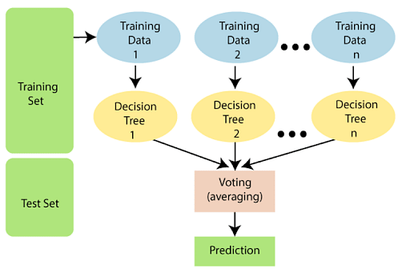
Working of Random Forest Algorithm

Slide 76
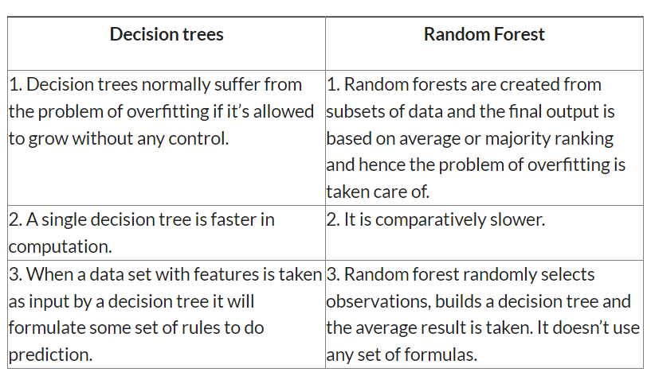

Slide 77
Advantages of Random Forest Algorithm
Can perform both Regression and classification tasks.
Produces good predictions that can be understood easily.
Can handle large data sets efficiently.
Provides a higher level of accuracy in predicting outcomes over the decision algorithm.

Slide 78
Disadvantages of Random Forest Algorithm
While using a Random Forest Algorithm, more resources are required for computation.
Consumes more time compared to the decision tree algorithm.
Less intuitive when we have an extensive collection of decision trees.
Extremely complex and requires more computational resources.

Slide 79
Overfitting and Underfitting Principles
What is Overfitting?
When a model performs very well for training data but has poor performance with test data (new data), it is known as overfitting. Overfitting can happen due to low bias and high variance.

Slide 80
Reasons for Overfitting
Data used for training is not cleaned and contains noise (garbage values) in it
The model has a high variance
The size of the training dataset used is not enough
The model is too complex

Slide 81
Ways to Tackle Overfitting
Using K-fold cross-validation
Using Regularization techniques such as Lasso and Ridge
Training model with sufficient data
Adopting ensembling techniques

Slide 82
What is Underfitting?
When a model has not learned the patterns in the training data well and is unable to generalize well on the new data, it is known as underfitting. An underfit model has poor performance on the training data and will result in unreliable predictions. Underfitting occurs due to high bias and low variance.

Slide 83
Reasons for Underfitting
Data used for training is not cleaned and contains noise (garbage values) in it
The model has a high bias
The size of the training dataset used is not enough
The model is too simple
Ways to Tackle Underfitting
Increase the number of features in the dataset
Increase model complexity
Reduce noise in the data
Increase the duration of training the data

